Slide 1
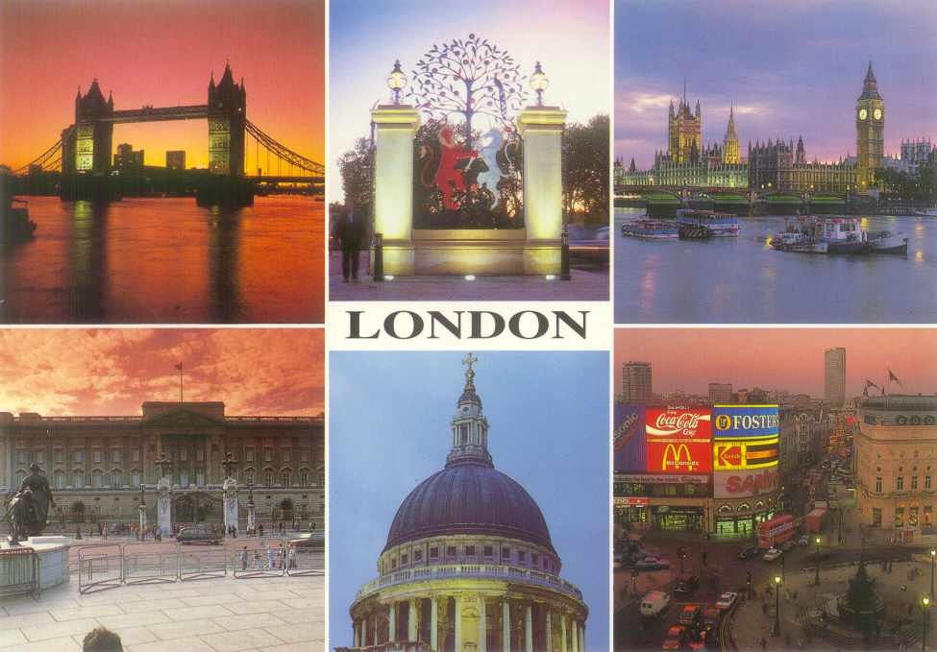
WELCOME TO LONDON!
Let us tour London

Slide 2
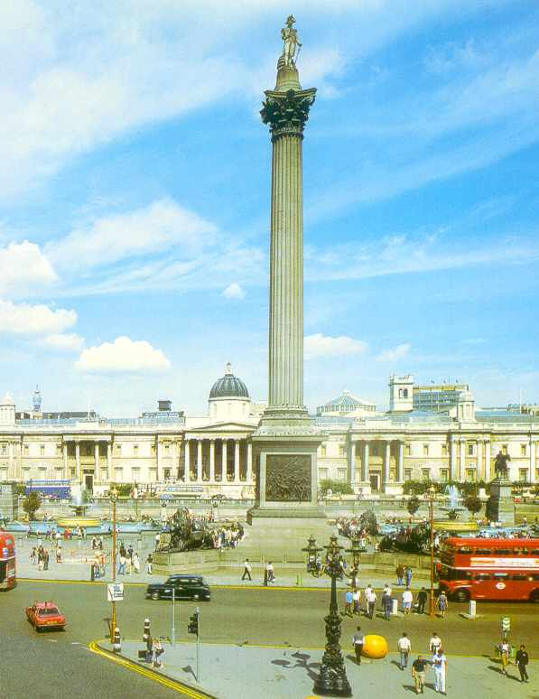
Trafalgar Square
There are always a lot of people and pigeons on the square.
In the middle of the square there is Admiral Nelson’s Column.

Slide 3
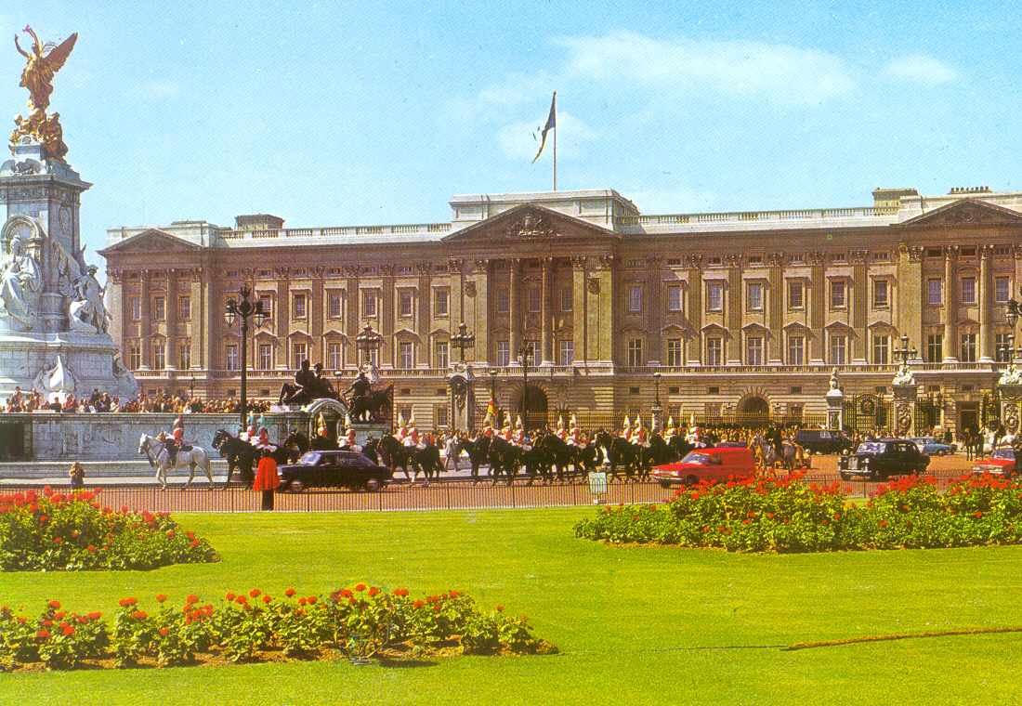
Buckingham Palace
This is the Queen’s home.
It was built in 1703.

Slide 4
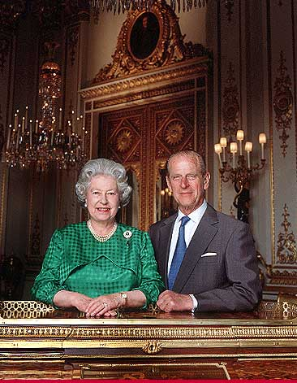
The Queen of Great Britain
The Queen of Great Britain is Elizabeth II. Her husband is Duke of Edinburgh.
They have got 4 grown-up children: Prince Charles, Princess Anne, Prince Andrew and Prince Edward.

Slide 5
The Royal Family

Slide 6
Prince William , the Duchess of Cambridge Catherine and their baby Prince George

Slide 7
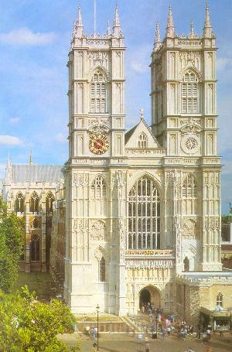
Westminster Abbey
This is a holy place.
All English kings have been crowned and buried in the church since 1308.

Slide 8
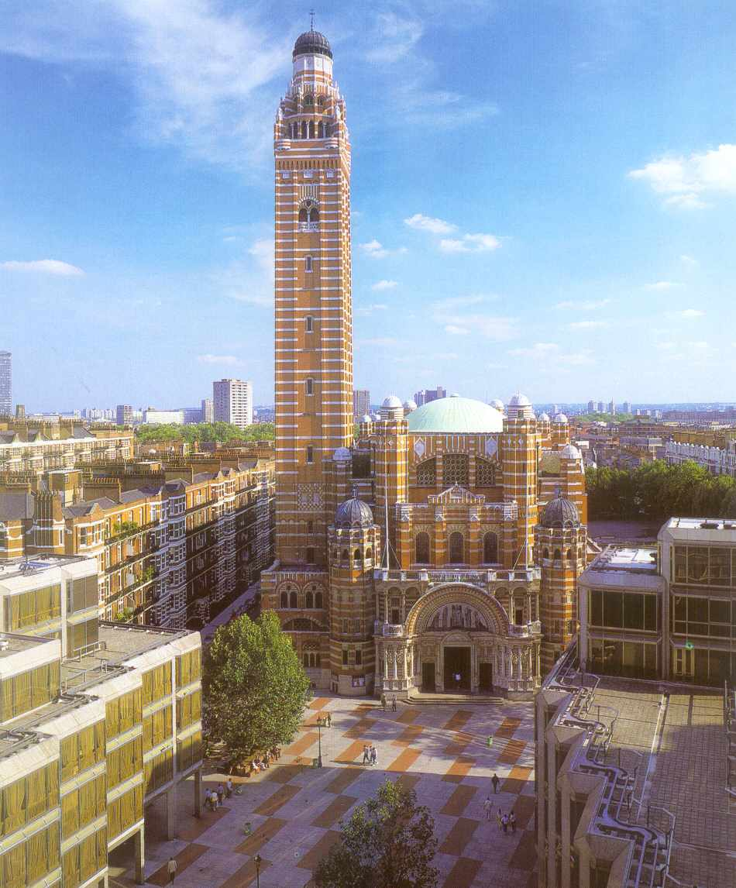
Westminster Cathedral
It was built between 1895 and 1903.
This is the seat of the Cardinal Archbishop and the leading Roman Catholic Church in England.
Its bell tower is 84 metres high.

Slide 9
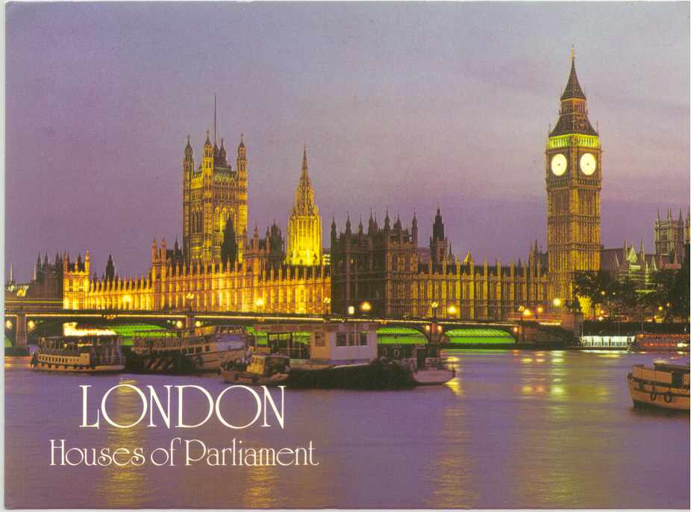
The Houses of Parliament
This big palace is the most famous building in the world – the British Parliament.
The building is 280 metres long.
There are more than 1000 rooms.

Slide 10
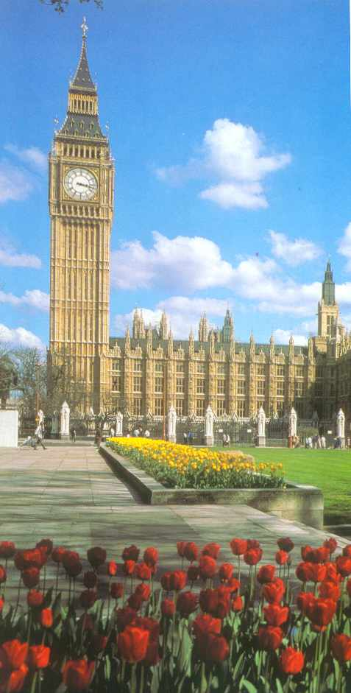
Big Ben
Big Ben, the big clock tower, is the symbol of London. It strikes hours.

Slide 11
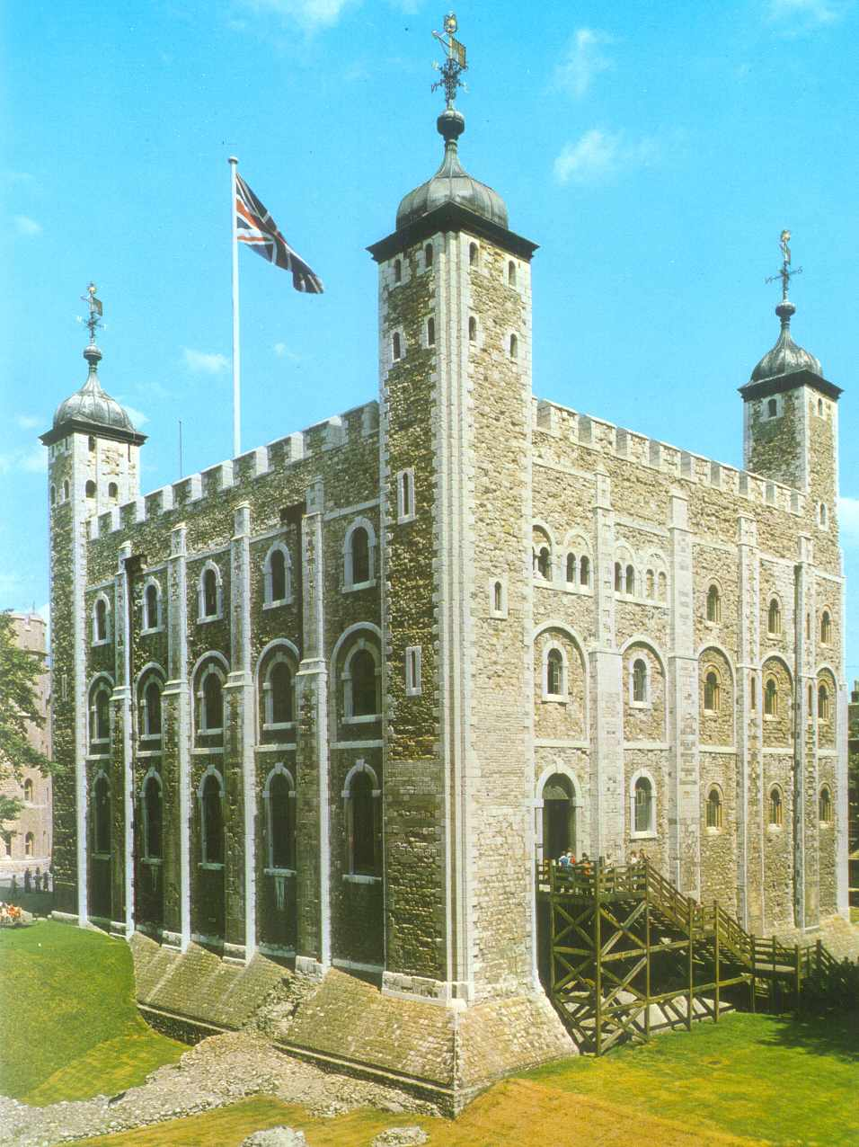
Tower
The Tower of London has been a fortress, a palace, an arsenal, a mint, a prison, an observatory, a zoo, the home of the Crown Jewels and a tourist attraction.

Slide 12
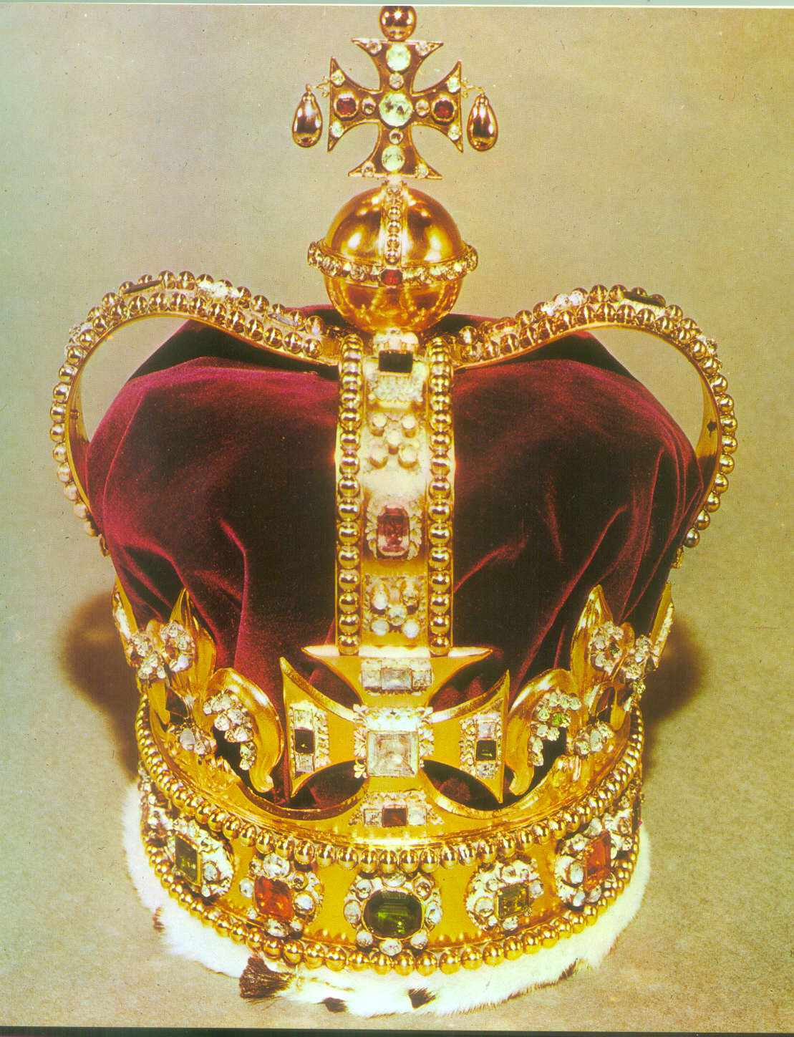
Imperial State Crown
The Tower’s greatest treasure is the Imperial State Crown.
There are 2 800 diamonds on it.

Slide 13
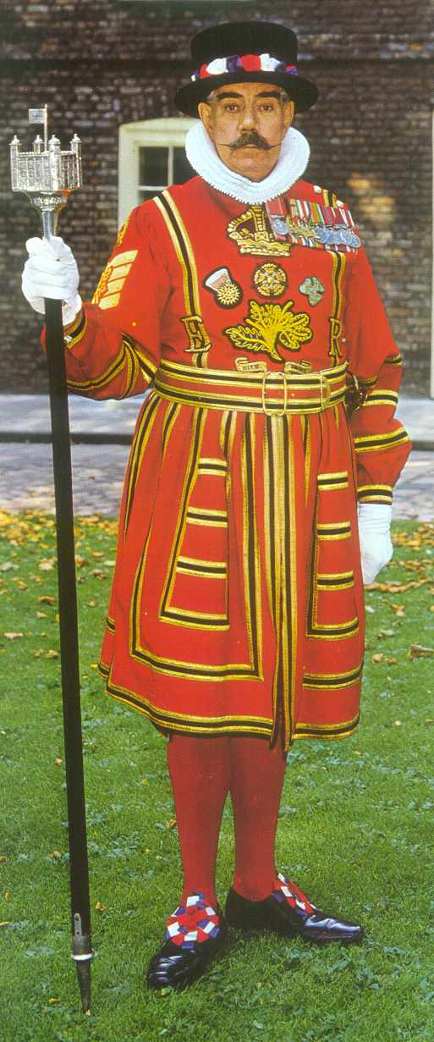
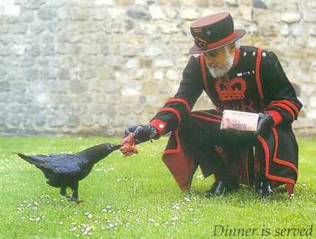
Beefeaters
The quards of the Tower are called Beefeaters.
The legend says that if the ravens leave, the Tower and the country will fall.

Slide 14
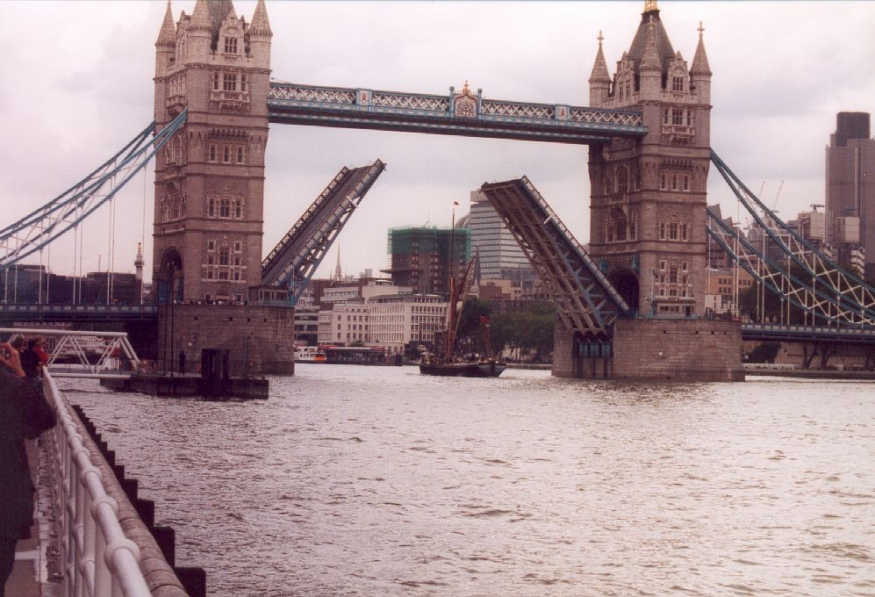
Tower Bridge
The most famous
bridge in London
is a Tower bridge.
Tower Bridge is a bascule-bridge.
The bascules will open to let ships pass through.

Slide 15
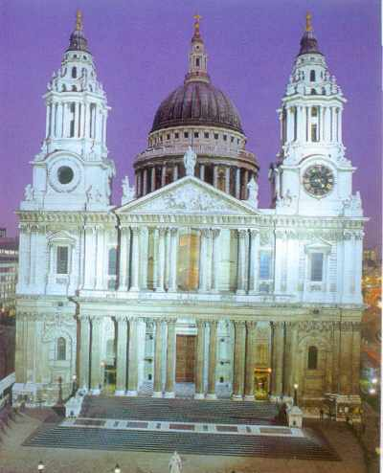
St. Paul’s Cathedral
St.Paul’s Cathedral is a famous building too.
Prince Charles and Princess Diana married here in 1981.

Slide 16
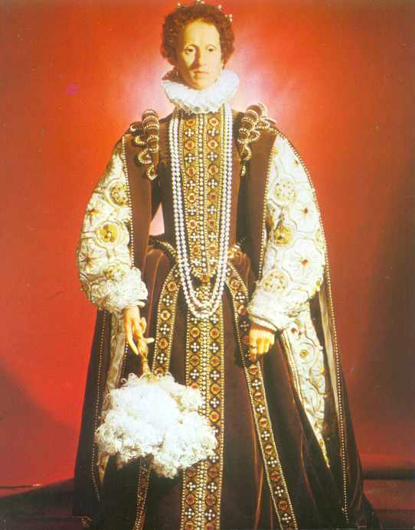
Madame Tussauds Waxmuseum
Here you can see famous people, good and bad, made of wax.
This is Queen Elizabeth I.

Slide 17
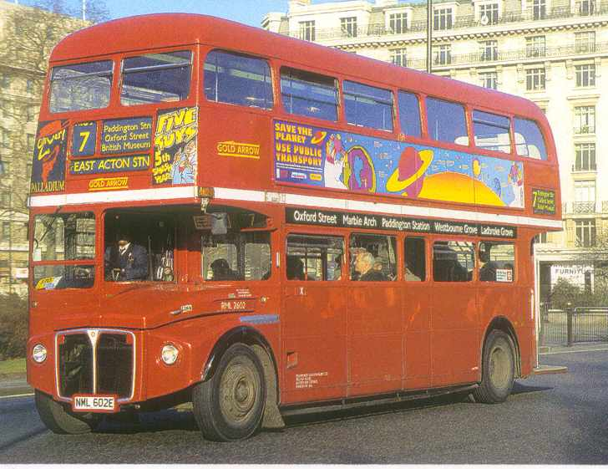
Double-deckers
There are big red buses called double-deckers in London.
People sit upstairs and downstairs on these buses.
Tourists like them very much.

Slide 18
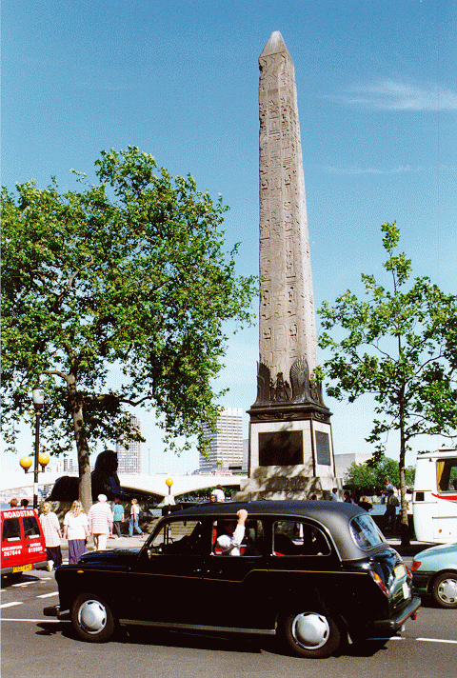
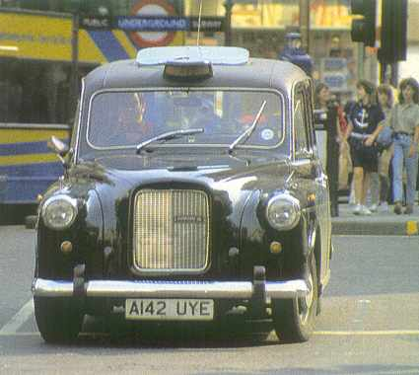
Taxis
Taxis in London are old-fashioned black cars.

Slide 19
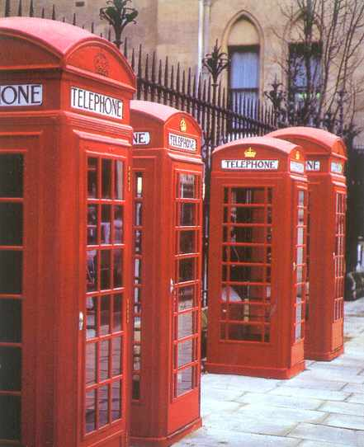
Telephone booths

Slide 20
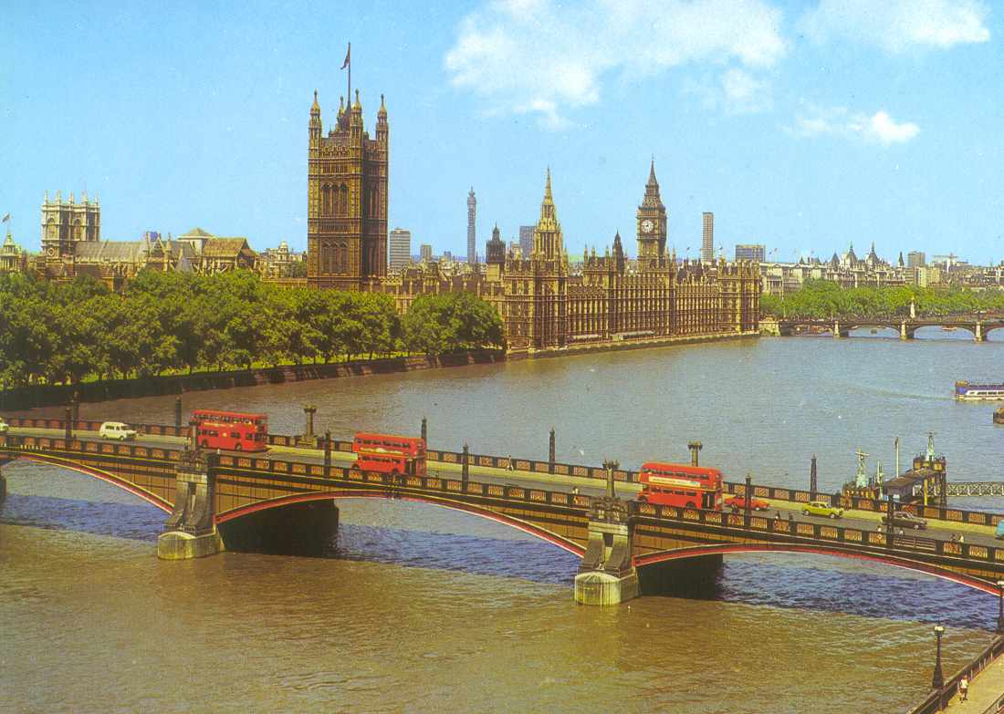
River Thames
Thames flows through London.
The River Thames is 338 km long.
It is 245 m wide here.
Even big seaships can visit London.

Slide 21
Oxford University and the University of Cambridge are both famous around the world.
Oxford
Cambridge

Slide 22
What the English Like to Eat
Fish and chips
Tea and Biscuits

